Slide 2
Espacenet search strategy

Slide 3
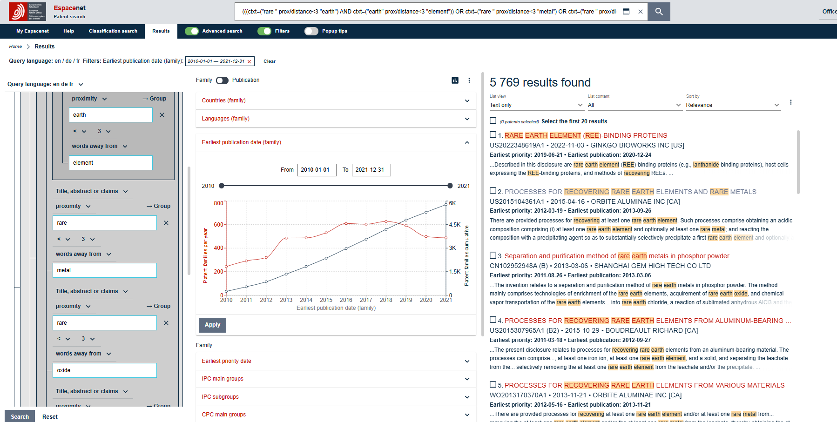
(((ctxt=("rare " prox/distance<3 "earth") AND ctxt=("earth" prox/distance<3 "element")) OR ctxt=("rare " prox/distance<3 "metal") OR ctxt=("rare " prox/distance<3 "oxide") OR ctxt=("light " prox/distance<3 "REE") OR ctxt=("heavy " prox/distance<3 "REE")) OR ctxt any "REE" OR ctxt any "lanthan*") AND (ctxt any "recov*" OR ctxt any "recycl*")

Slide 4
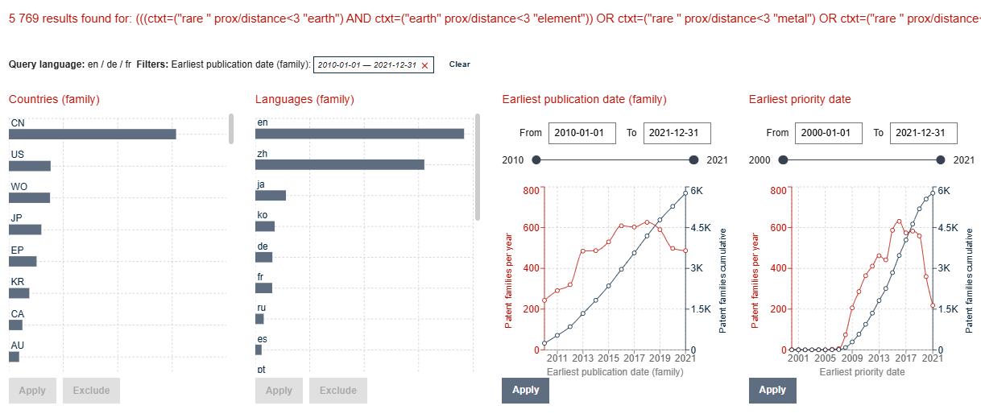

Slide 5
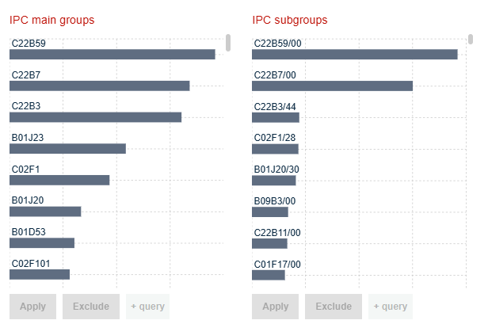
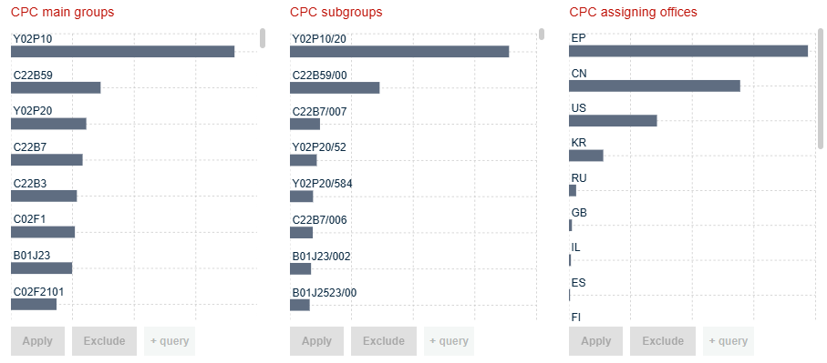
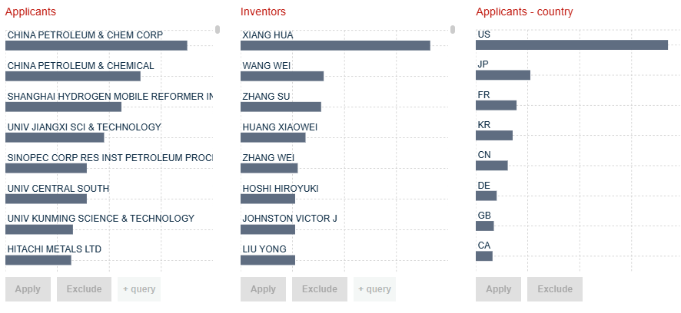
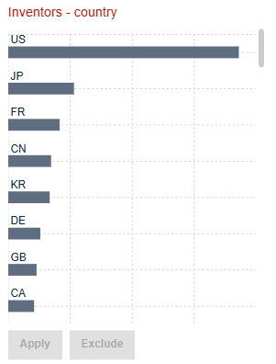

Slide 6
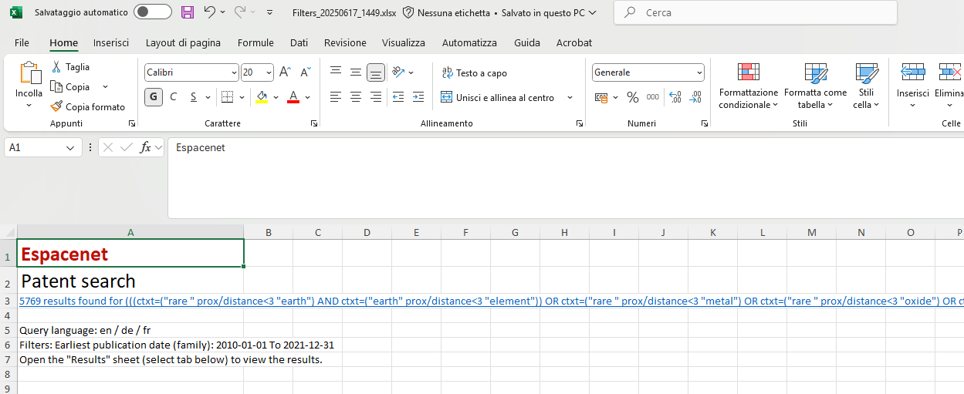
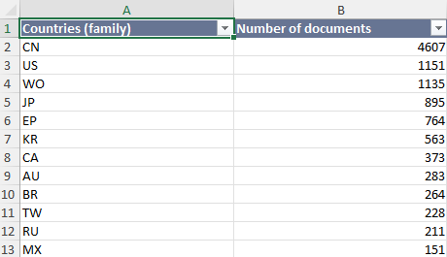
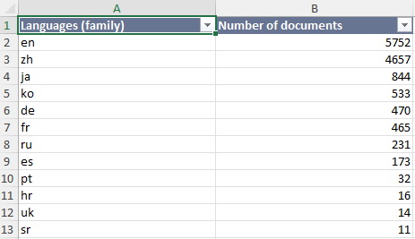
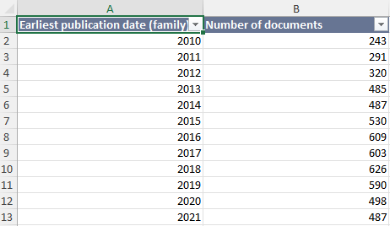
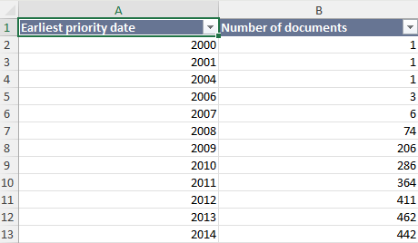
Etc.

Slide 7
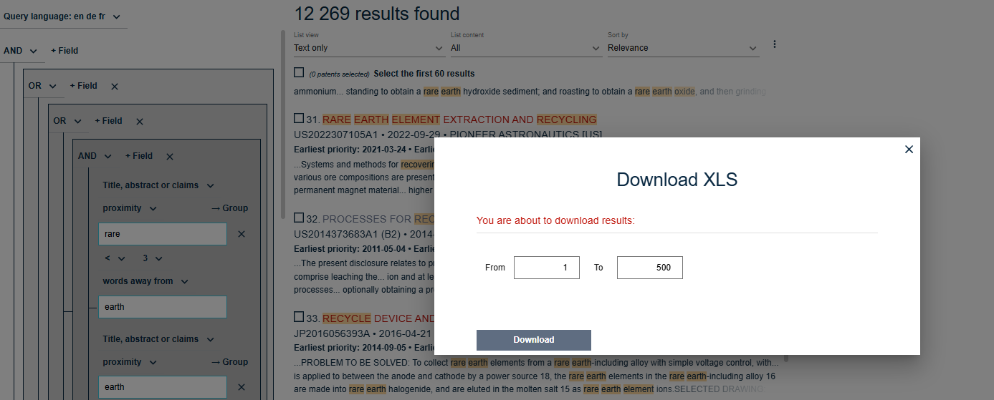

Slide 8
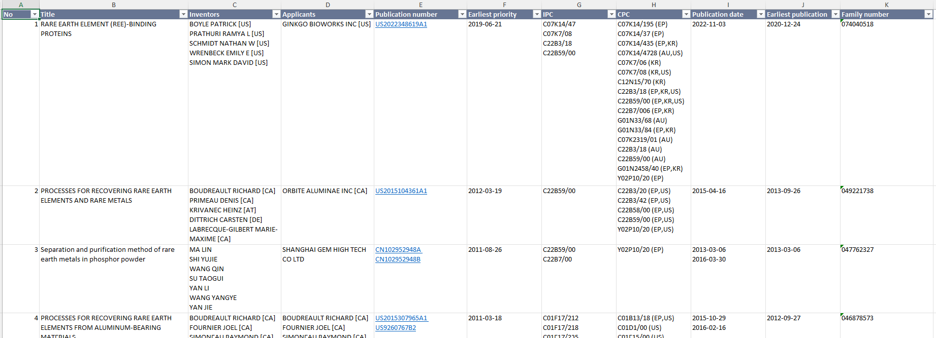
Can be imported in Patstat or in TIP (as docdb_family_id)

Slide 9
Patstat online search strategy

Slide 10
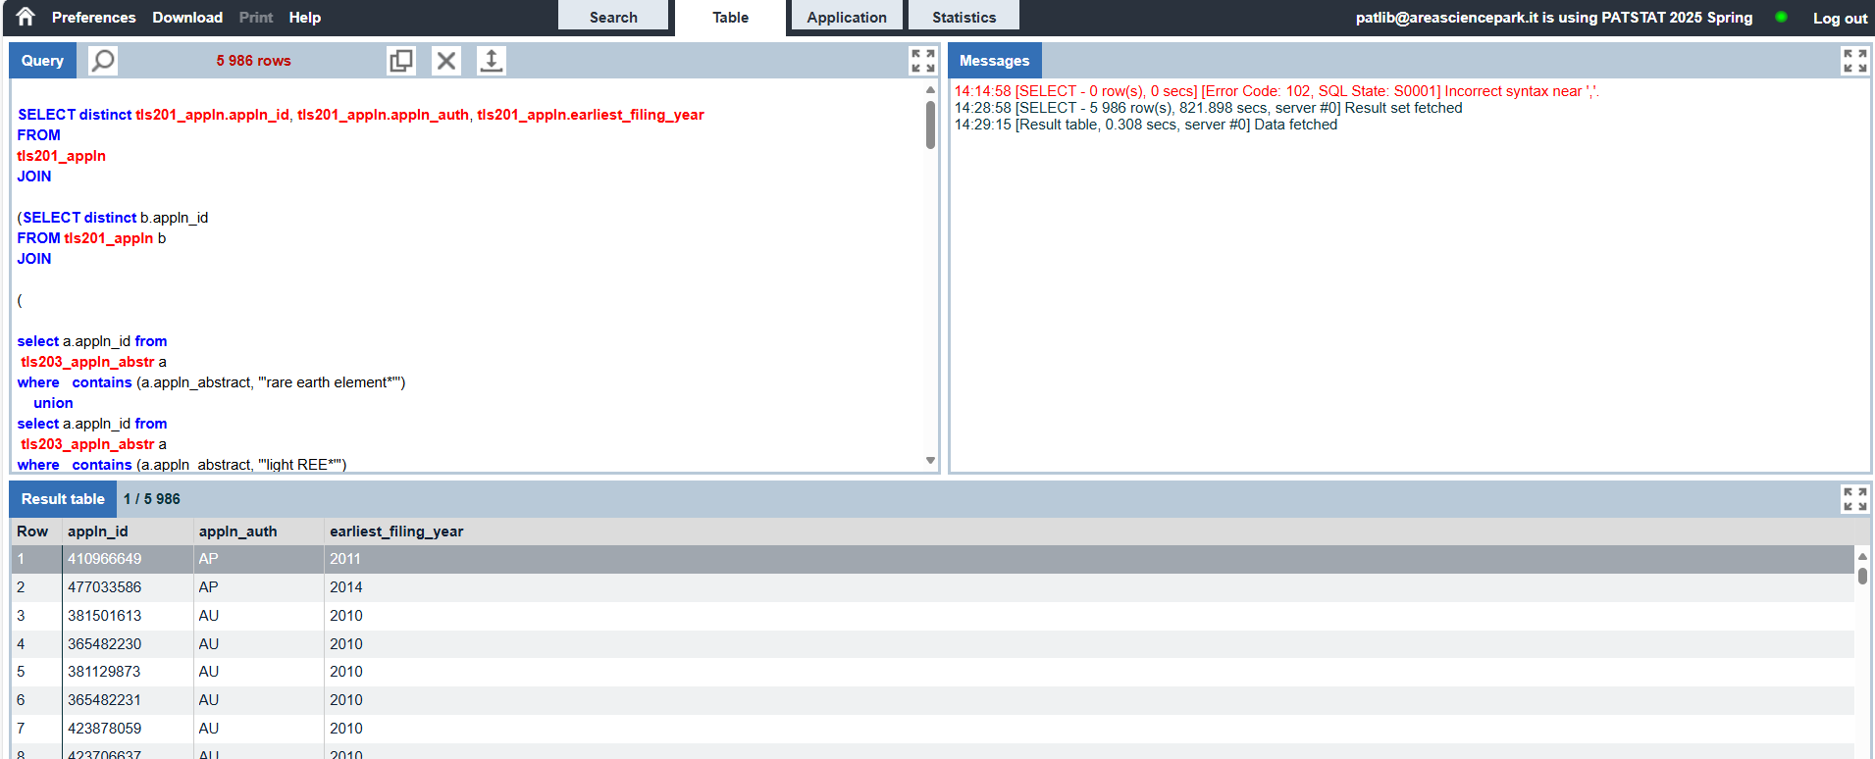

Slide 11
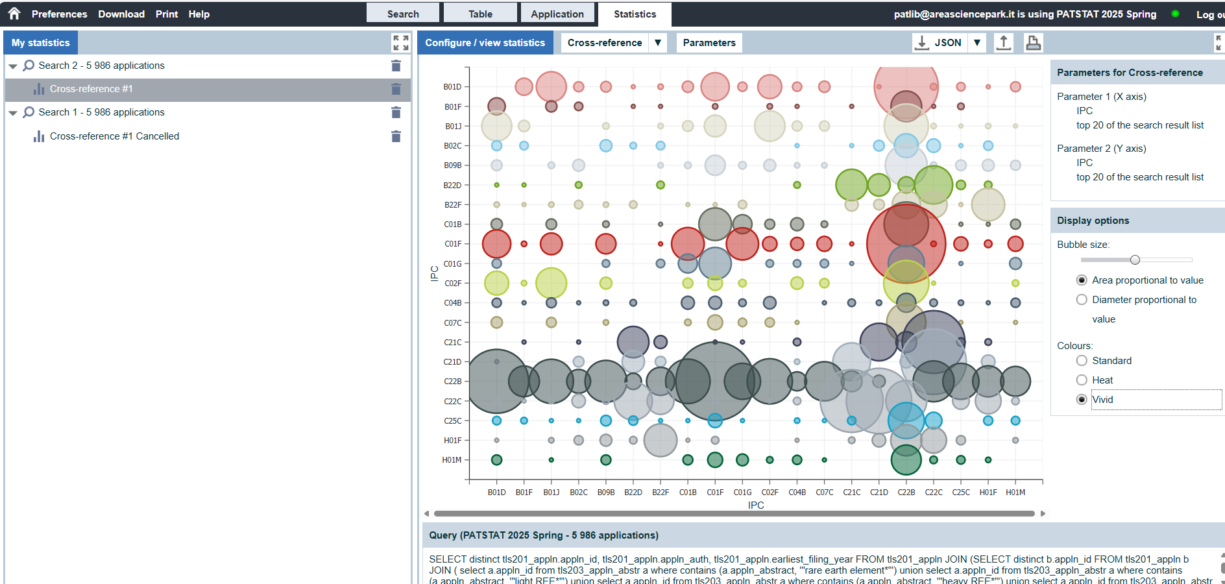

Slide 12
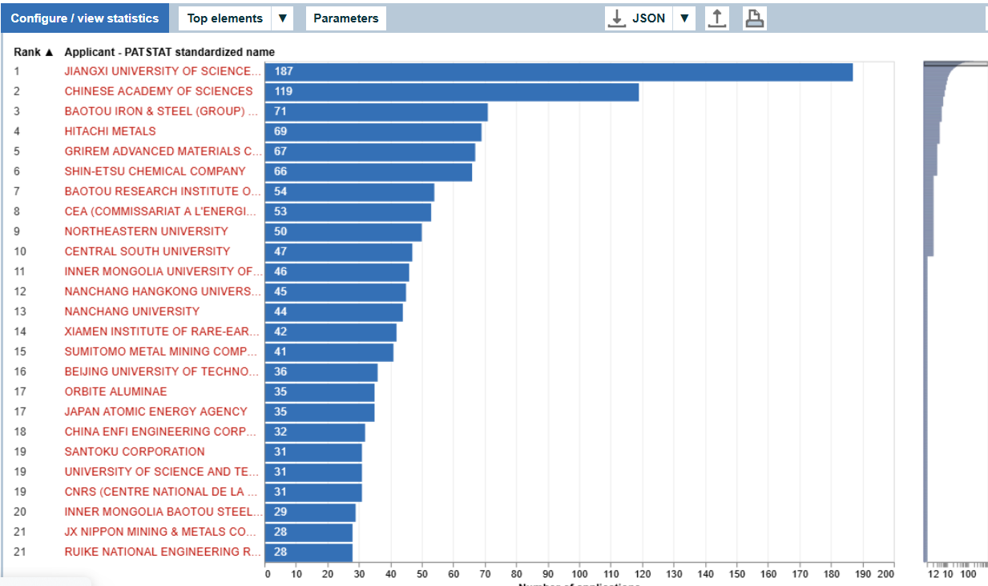
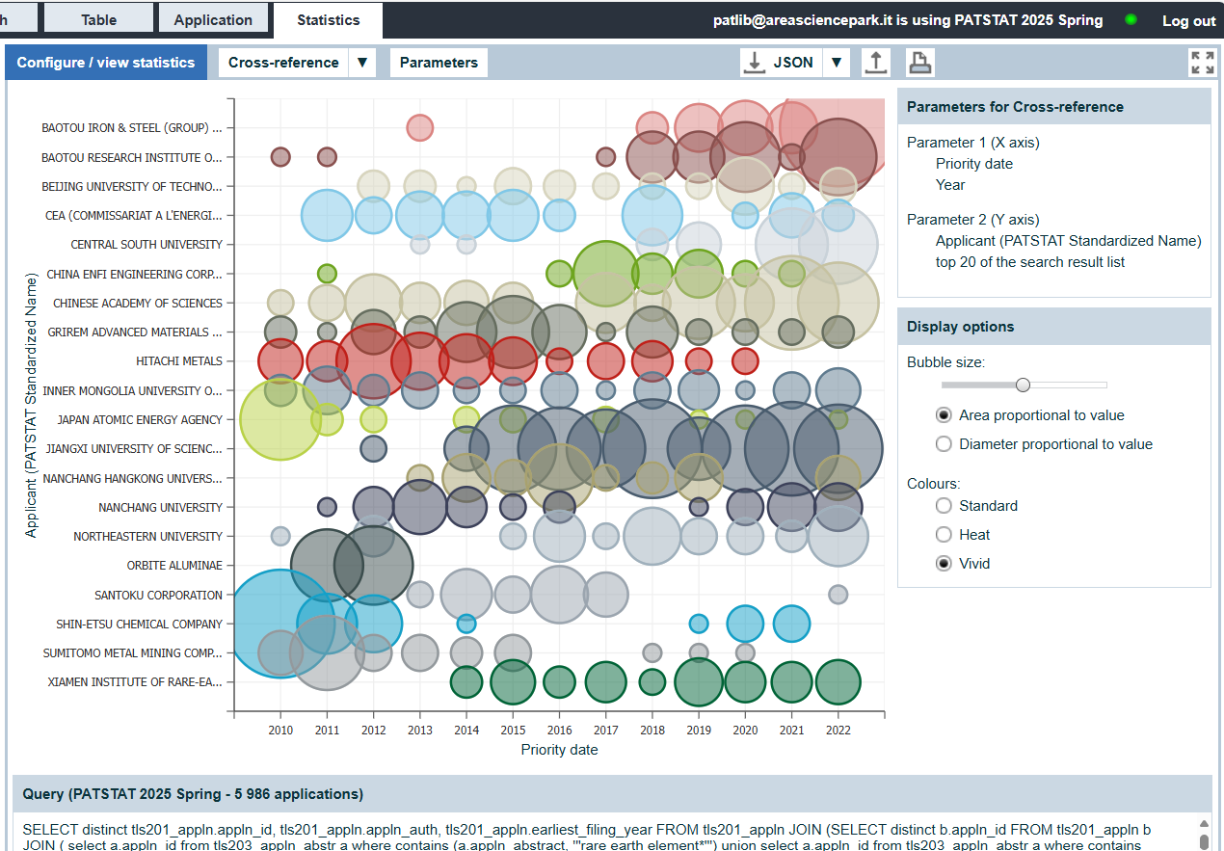

Slide 13
Downloading csv from Patstat and re-organization for MS Power BI uploading…

Slide 14
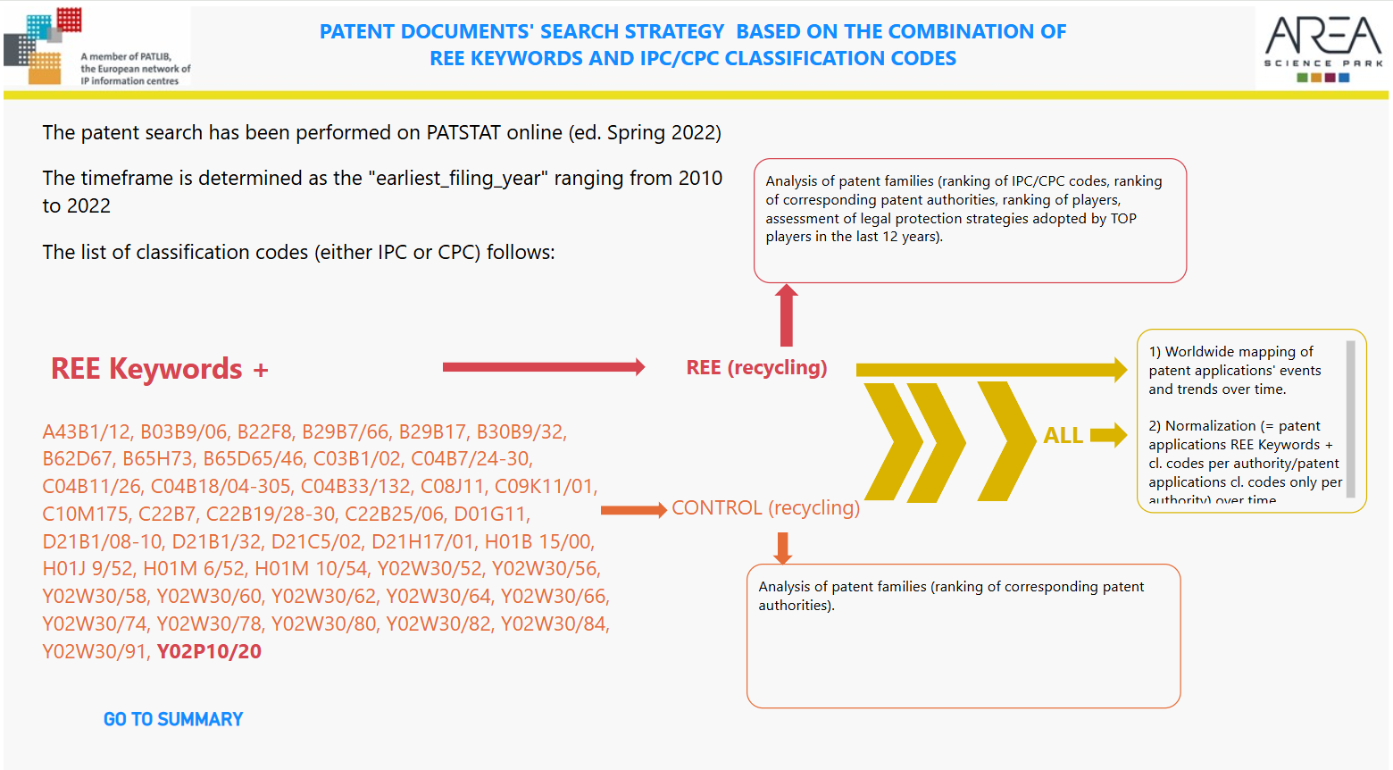

Slide 15
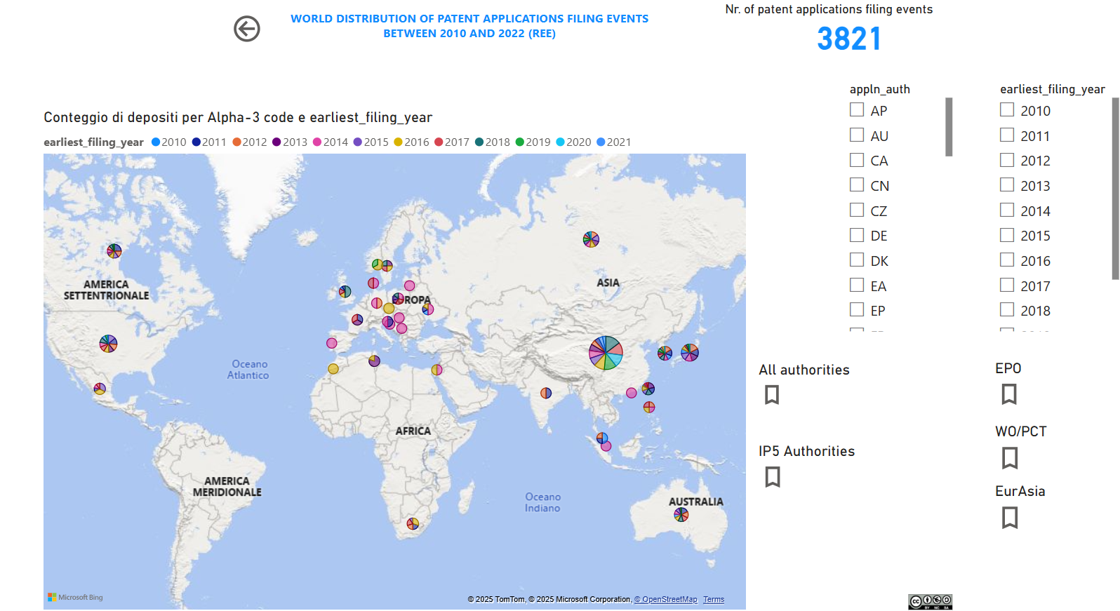

Slide 16
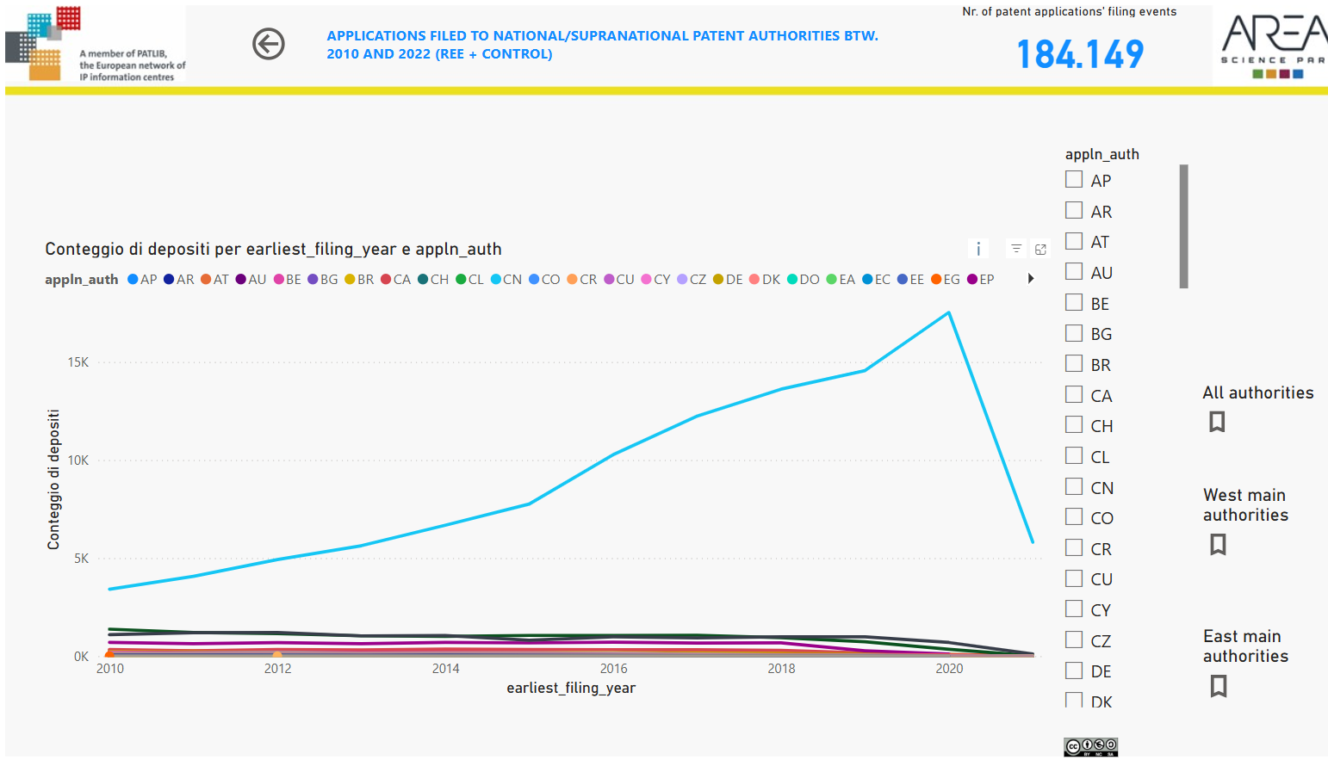

Slide 17
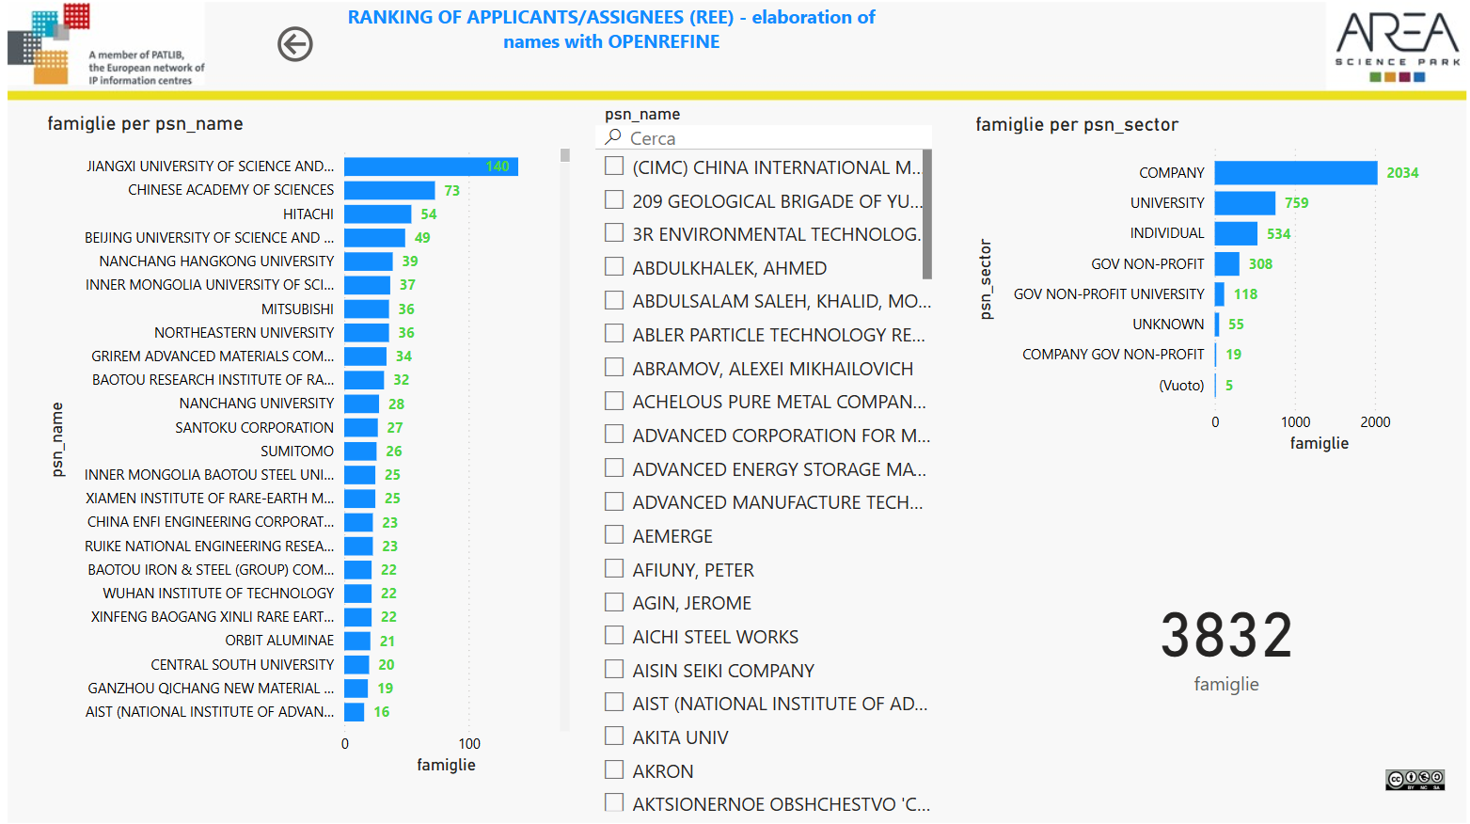

Slide 18
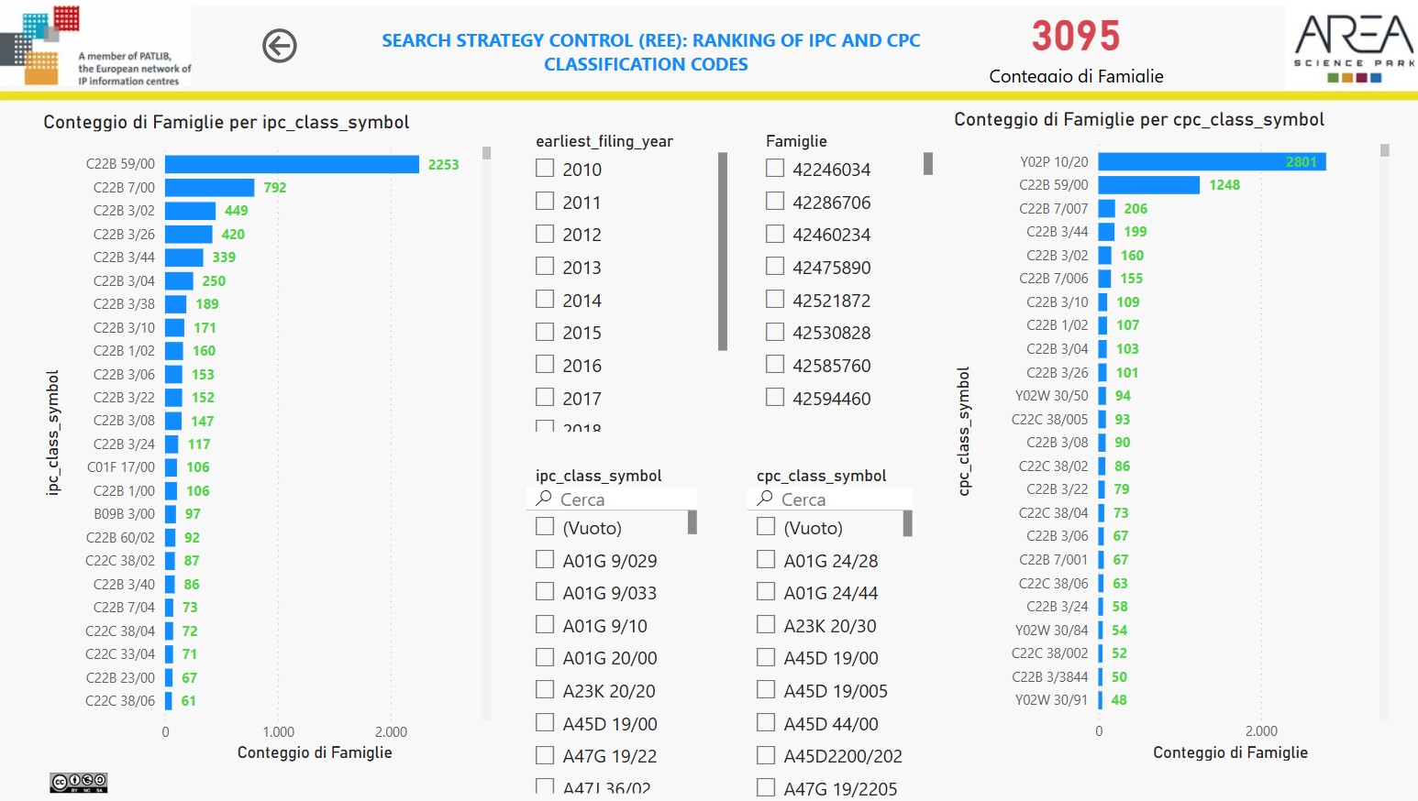

Slide 19
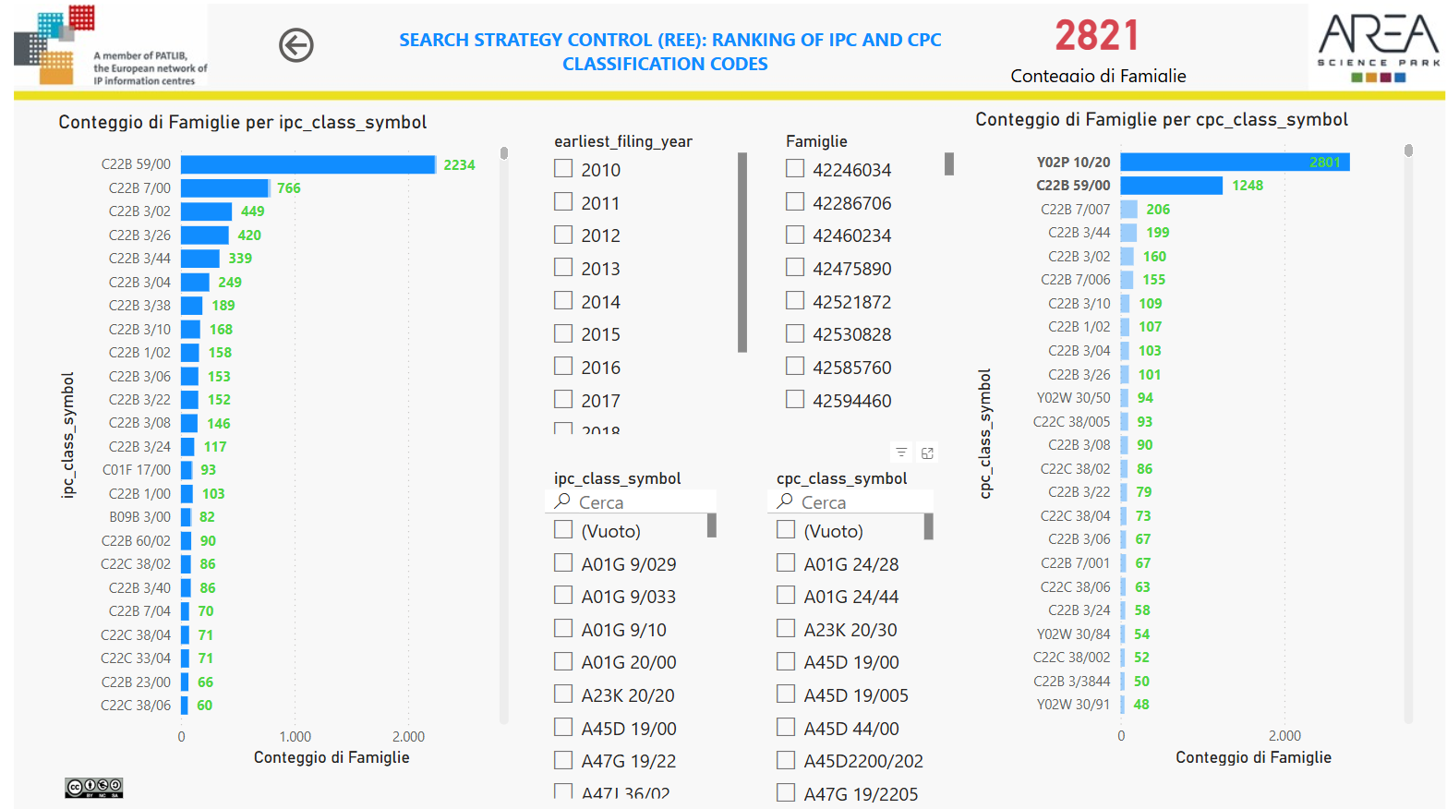
Combinations of classification codes

Slide 20
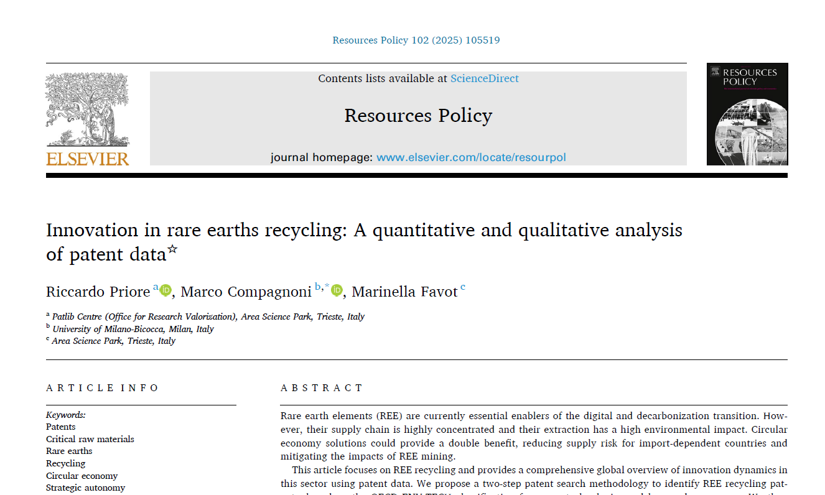

Slide 21
Search on «TIP» accessing Patstat tables:

Slide 22
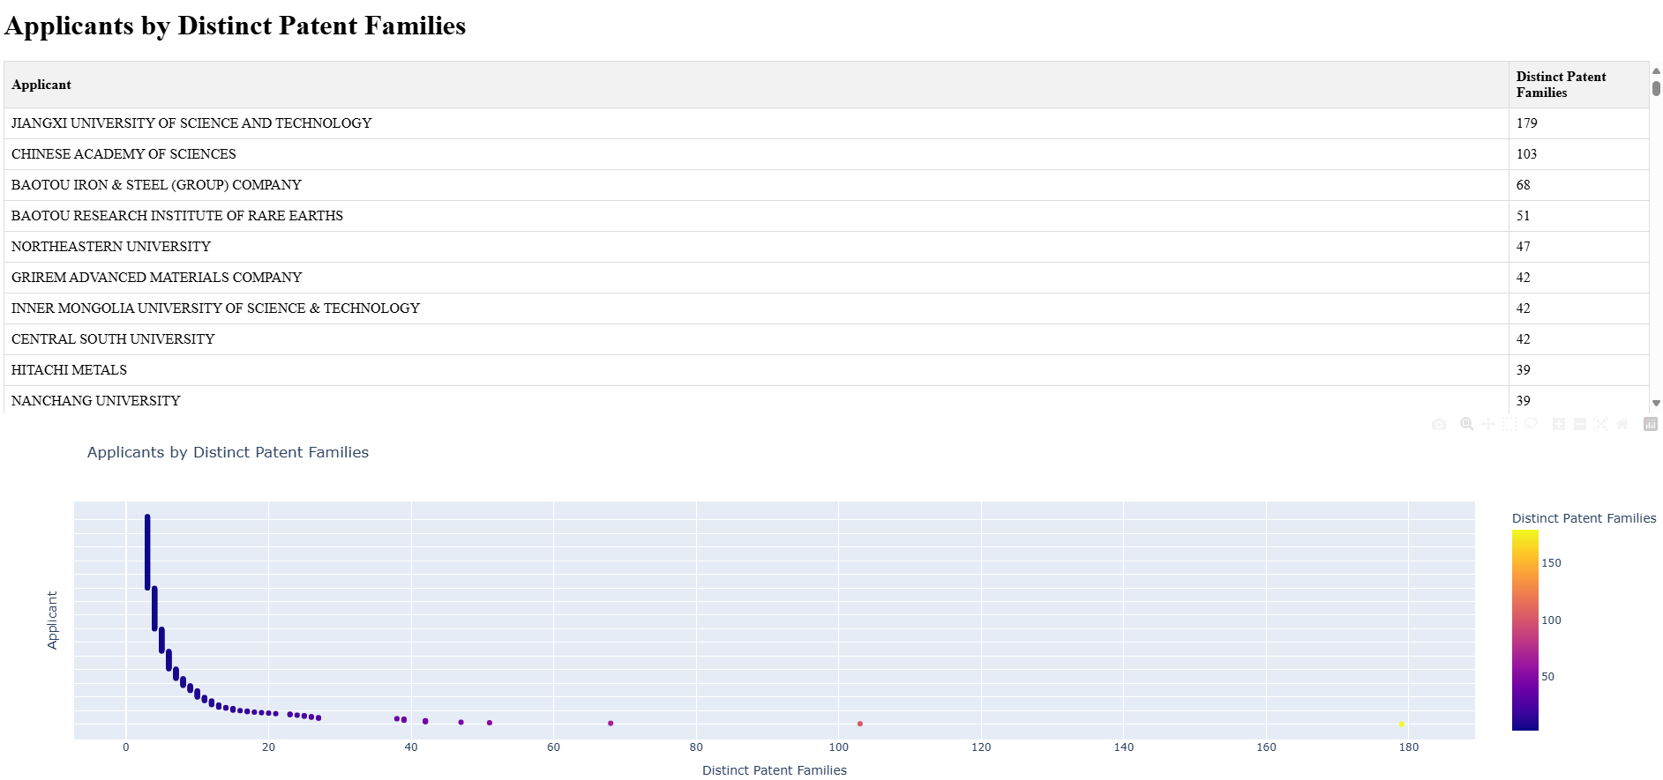

Slide 23
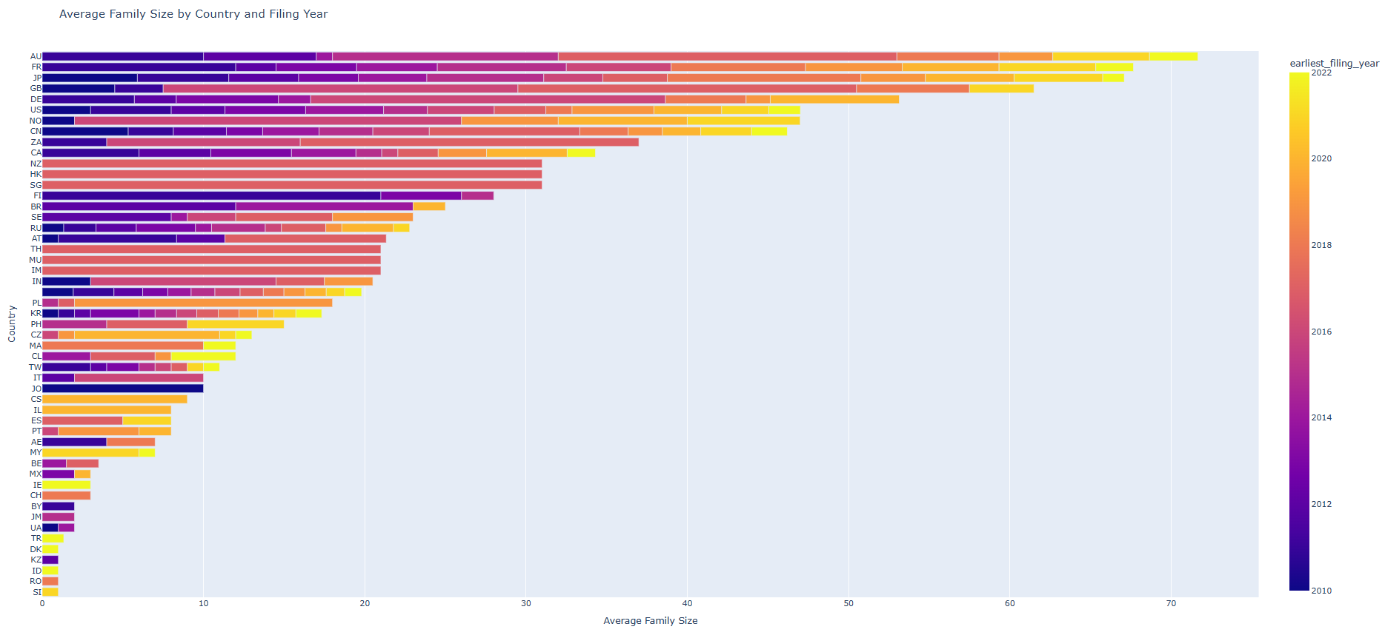

Slide 24
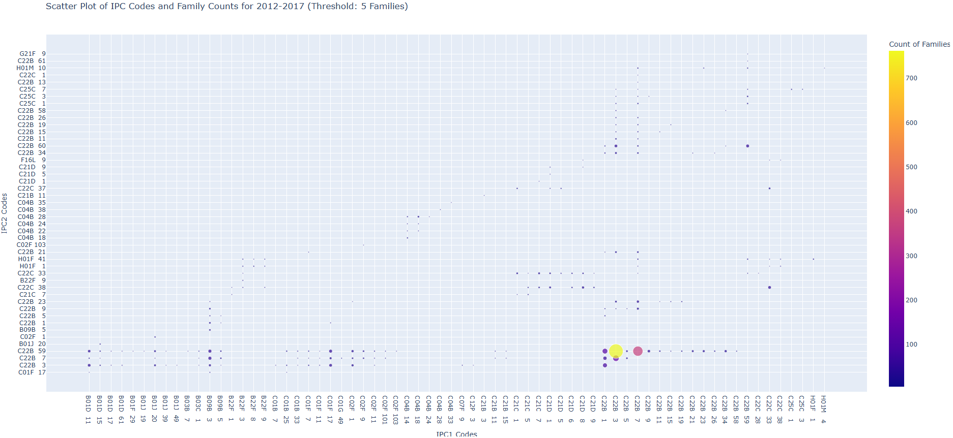

Slide 25
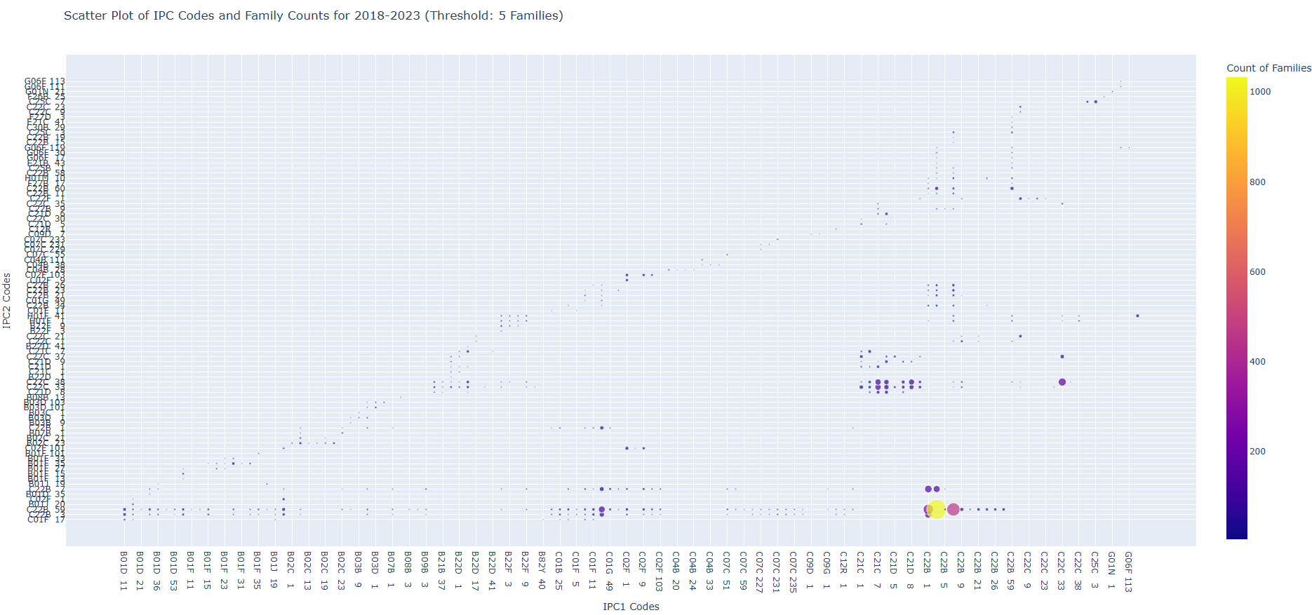

Slide 26
Floor to TIP + AI search strategy…

